Slide 1

Cottonil Data Driven Decision System
By Mohammed Alaa

Slide 2
Cottonil Business Intelligence Dashboards: Executive Summary
Project Idea and Solution The project’s core idea is to establish an integrated Business Intelligence (BI) system for Cottonil, translating raw operational data into actionable visual insights. The solution provides three interactive dashboards covering Sales & Profit Analytics and Purchases Analytics. This empowers management to make rapid, data-driven decisions by monitoring key performance indicators (KPIs) like Net Sales, Total Orders, Profit Margins, and Inventory/Purchasing effectiveness across various product categories.
What makes this project stand out is its strong technical data engineering, where unstructured HTML data was extracted and transformed into structured Excel files using Python. It also provides comprehensive end-to-end analysis, connecting sales, profits, and purchasing to highlight product-level performance. Additionally, the dashboards feature a professional, modern design with rich filters for flexible and user friendly exploration.

Slide 3
Project Beneficiaries and Key Features
Target Users (Beneficiaries)
The Project cater to several key organizational roles:
• Executive Management: Focused on overall profitability, market share, and high-level performance metrics.
• Sales & Marketing Managers: Concerned with product performance, order trends, and effective sales periods.
• Purchasing & Supply Chain Managers: Focused on procurement costs, supplier efficiency, and inventory volumes. • Financial Analysts: Interested in net profit margins, cost analysis, and the correlation between sales and purchasing.
2. Key Features and Problems Solved
The dashboard features solve critical business challenges:
• Top-Line KPIs ($3.17M Net Sales): Problem Solved: Eliminates the need for manual reports to assess the company's financial health. Provides immediate performance assessment for Executives.
• Trend Charts (Sales & Profit by Month): Problem Solved: Identifies crucial seasonality and unexpected spikes or dips. Helps Sales Managers forecast accurately and optimize marketing timing.
• Product-Level Analytics (Sales/Purchases by Item): Problem Solved: Addresses the lack of visibility into which specific products are most profitable or costly. Guides production and inventory decisions by highlighting best-performing items.
• Interactive Filters (Month, Quarter, Item, Vendor): Problem Solved: Reduces reliance on analysts for every specific query. Enables Self-Service Analysis across all departments for quick, detailed answers.
• Supplier Performance Data (Purchases Dashboard): Problem Solved: Resolves difficulty in evaluating vendors based on actual performance and cost-efficiency. Optimizes the supply chain for Purchasing Managers.

Slide 4
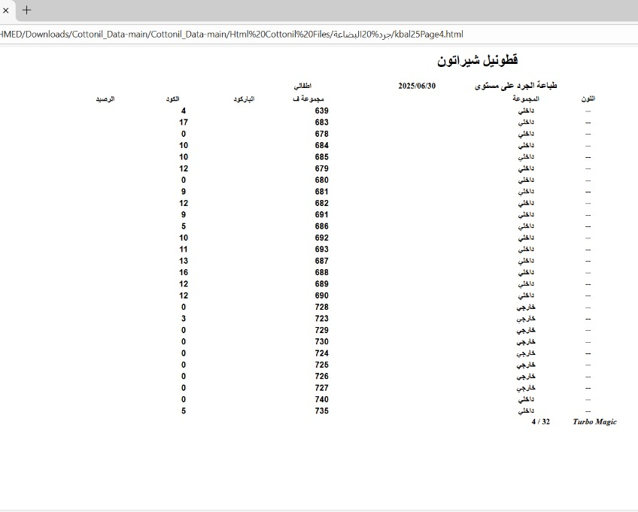
Data Architecture & Technical Workflow
1. Data Source & ETL Process
Source: Unstructured operational reports exported as HTML files.
Extraction & Transformation (Key Technical Differentiator):
Python (Pandas) was used to parse HTML tables, cleanse inconsistencies, and convert the data into a structured format.
Storage & Loading:
The cleaned dataset was saved as Excel files and then imported into the BI tool for data modeling and visualization.
2. Data Model (Schema & Entities)
Model Type: Star Schema optimized for high-performance analytics.
Fact Tables: Sales and Purchases (containing all measurable metrics).
Dimension Tables: Items, Vendors, and Calendar (supporting slicing, filtering, and detailed drill-down).
Relationships: One-to-Many (1:*) relationships connecting Fact and Dimension tables using keys such as Product Barcode and Transaction Dates.

Slide 5
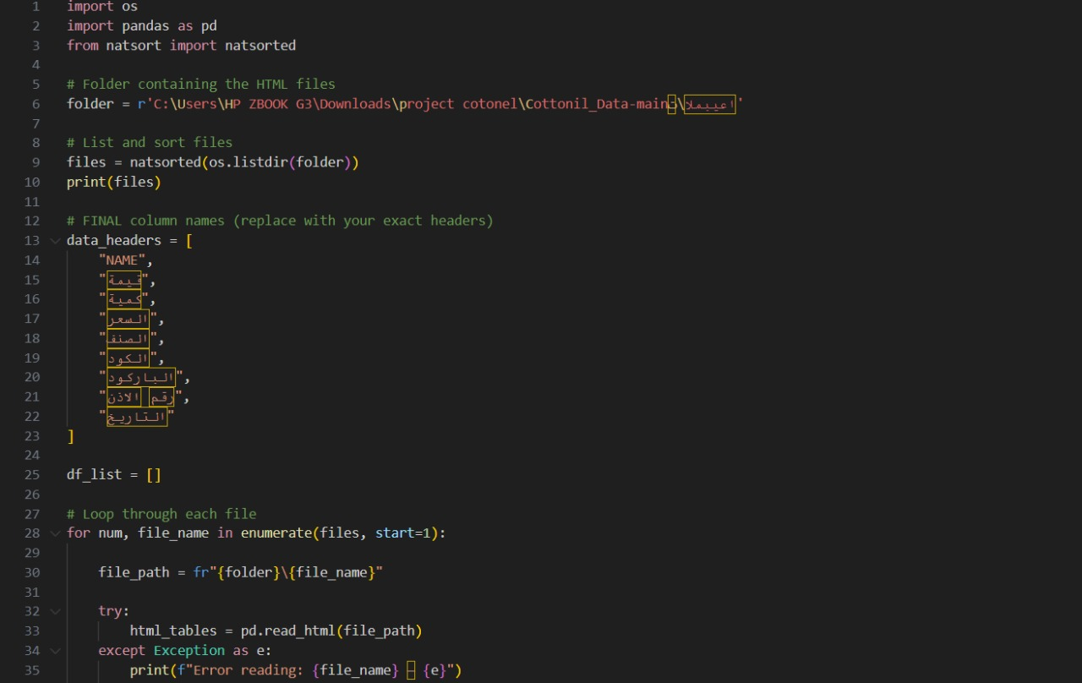
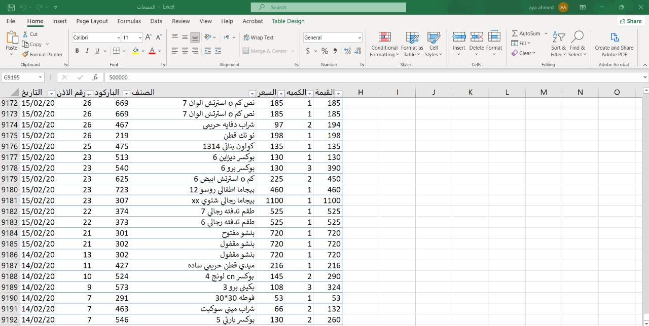
Using Python to Turn HTML Files Into Excel Sheets

Slide 6
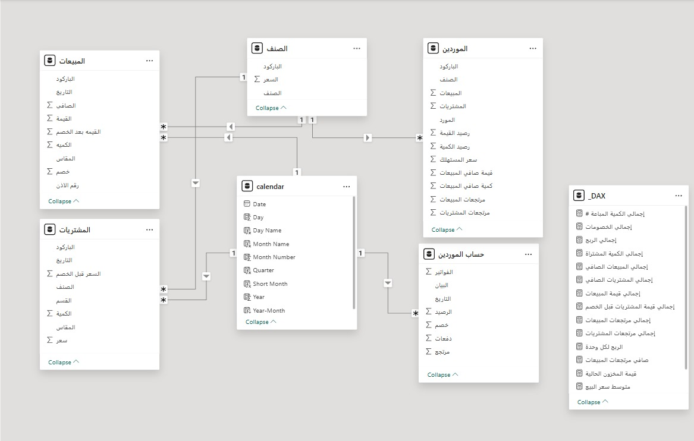
Data Modeling: Star Schema
Project uses a Star Schema for efficient BI reporting and fast analytics.
1.Fact Tables (Metrics) Contain transactional data:
•Sales: transaction value, quantity, discount
•Purchases: procurement costs and details
•Vendors Account (Ledger): supplier payments and balances
2.Dimension Tables (Context) Provide descriptive details:
•Item: product details (size, color, category)
•Vendors: supplier information
•Calendar: time dimension for trend analysis
3.Calculated Measures (DAX Layer) Stores KPIs like Net Profit and Net Sales for consistent reporting.

Slide 7
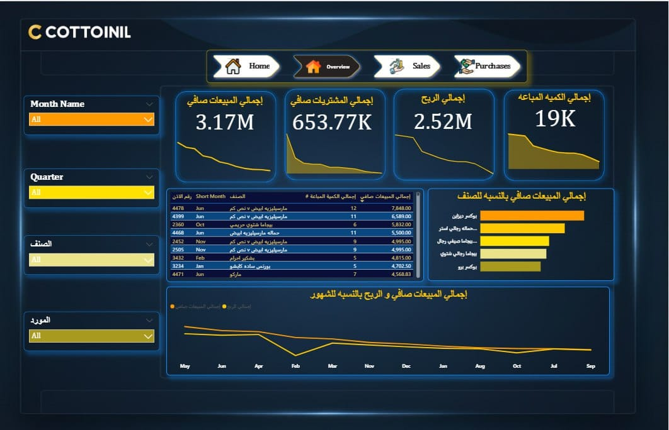
Conclusion: Strategic Insights & Recommendations
Key Findings and Observations
• Strong Profitability: Net Sales are $3.17M with Gross Profit at $2.52M, indicating an exceptionally high-profit margin and effective cost control.
• The Dominant Product: The "Boxer Design" item is the clear leader across the board, topping both Net Sales and Purchases Volume. This product is the core revenue driver
.• Volatile Trends: The monthly Sales/Profit trend shows significant volatility that needs further investigation (e.g., seasonality vs. supply chain issues)
.• Inventory Efficiency: Purchases value ($653.77K) is low relative to profit, suggesting tight inventory management or a highly successful sales strategy.

Slide 8
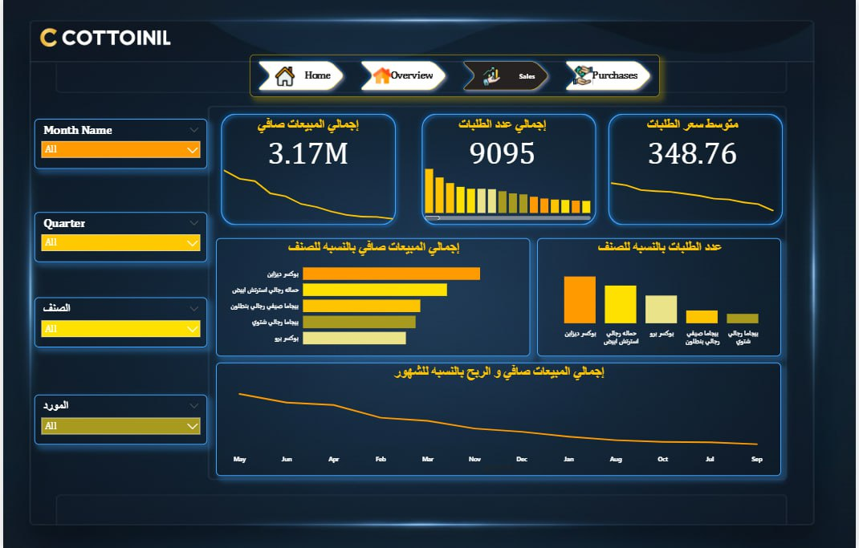
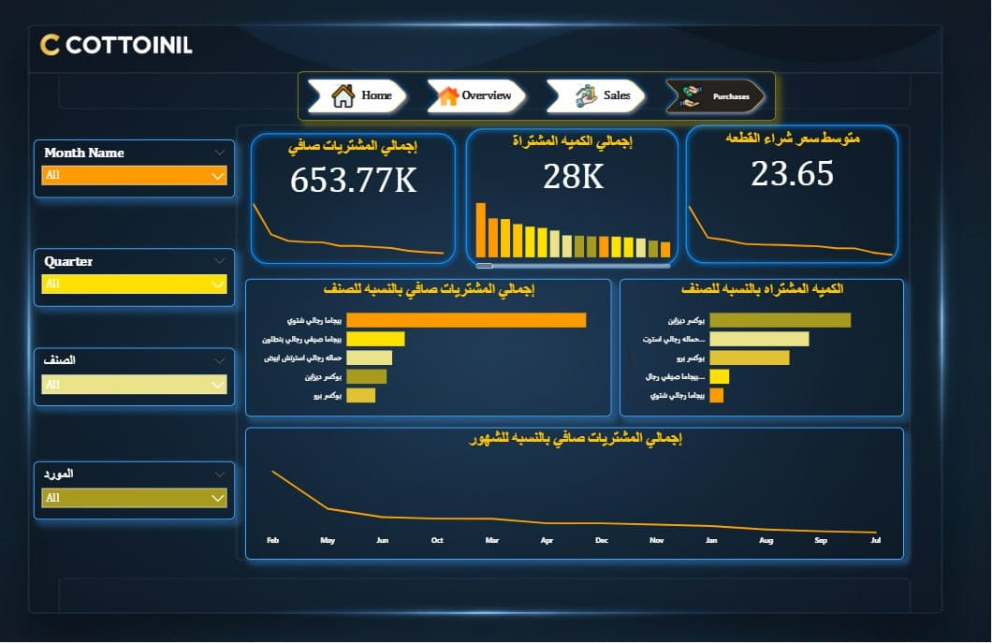
2. Strategic Recommendations (Actionable Solutions)
• Product Bundling Strategy (Sales/Marketing): Action: Leverage the dominance of "Boxer Design" by bundling it with lower-performing items (e e.g., Pajamas) to increase Average Order Value (AOV) and diversify sales.
• Supplier Cost Reduction (Purchasing/Finance): Action: Initiate immediate re-negotiation with key suppliers for "Boxer Design" to secure volume discounts, aiming to reduce the average unit purchase price of 23.65.
• Risk Mitigation & Diversification (Executive/Planning): Action: Allocate targeted marketing spend to the second and third best-selling items to reduce the company’s dependency risk on a single product.
• Investigate Time Fluctuations (Management): Action: Use the interactive dashboard to deep-dive into monthly variances to differentiate between predictable seasonality and correctable operational bottlenecks.

Slide 9
Yousef Ahmed Sobhy
Project Team Members
Mohamed Alaa Galal
Team Leader
Yousef Ahmed Sobhy
Data Visualization
Elham Adel Elsayed
Data Preprocessing
Tasneem Hazem Zahran
Data Modeling
Mohamed Mahmoud Morsy
Coding
Yousef Magdi Shalaby
Dax

Slide 10
Thank You

